Slide 1
Dates
Almost every data set contains dates
Compute the number of days, months or years between 2 dates
Analyze longitudinal data
Sorting data sets by dates
(last visit, first visit, etc.)

Slide 2
SAS offers date, time, and datetime variables

Slide 3
Examples :
Date: 10/04/2012
Time: 12:30:01
Date & Time: 10/04/2012:12:30:00

Slide 4
DATES
Examples of different ways you can write dates:
09/22/2012
09/22/12
9-22-2012
22SEP2012
22/9/2012
09222012
22 September 2012

Slide 5
Date Cutoff
When SAS sees a date with a 2 digit year like
9/22/12
SAS has to decide in which century the date belongs
Is the year 2012 or 1912 or 1812;
You can change the value of the cutoff with OPTIONS YEARCUTOFF=1950; This option tells SAS that all your dates will start with day 0 on 1/1/1950

Slide 6
Internal Storage of SAS Dates
01/01/1960 => 0
01/02/1960 => 1
12/31/1959 => -1
09/23/2010 => 18528
09/25/2012 => 19261
10/02/2014 => 19997

Slide 7
SAS date value
is a value that represents the number of days between January 1, 1960, and a specified date.
SAS can perform calculations on dates ranging from A.D. 1582 to A.D. 19,900.
Dates before January 1, 1960, are negative numbers; dates after are positive numbers.
SAS date values account for all leap year days, including the leap year day in the year 2000.
SAS date values can reliably tell you what day of the week a particular day fell on as far back as September 1752, when the calendar was adjusted by dropping several days. SAS day-of-the-week and length-of-time calculations are accurate in the future to A.D. 19,900.

Slide 8
☞ It is important to remember that once a date has been read in and converted into a number, it is treated as any other numeric variable in SAS

Slide 9
SAS date value
Various SAS language elements are available to handle SAS date values:
functions,
formats
informats
if you use a incorrect date, Feb 31, 2010 SAS will generate an error message and will set the variable to missing

Slide 10
Formats for Dates
Date (In)Format
09/25/2012 MMDDYY10.
09/25/12 MMDDYY8.
09-25-12 MMDDYY8.
9-25-2012 MMDDYY10.
25SEP2012 DATE9.
25SEP12 DATE7.
25/9/2012 DDMMYY10.
09252012 MMDDYY8.
September 25, 2012 Worddate.

Slide 11
data test_dates1;
/* defining INPUT AND OUTPUT formats for dates */
informat admit dischrg MMDDYY8. dob MMDDYY10.;
format admit dischrg dob date7.;
/* Reading dates */
Infile datalines DSD dlm=“ “ ;
input mr_nr admit dischrg dob;
datalines;
128120 10/9/08 10/24/08 09/15/1954
157673 9/20/88 10/17/08 09/25/1908
;
run;
proc print;
run;

Slide 12
SAS Functions for Dates
TODAY() or DATE ()
MDY(month,day,year)
DATEPART (date&time)
DAY (date)
WEEKDAY (date) 1=Sunday, 2= Monday
MONTH (date)
YEAR (date)
QTR (date)
YRDIF (sdate,edate,’Actual’)

Slide 13
Example
data usa;
set u.usa2014;
if tx_year < 2010 then delete;
if tx_year = 2014 then delete;
if dtype="L" then delete;
if Tx_numbr > 1 then delete;
tx_day=weekday(tx_dt);
run;
proc freq;
table tx_day/chisq;
run;
tx_day | Frequency | Percent | Cumulative Frequency
1 | 636 | 12.23 | 636
2 | 771 | 14.82 | 1407
3 | 804 | 15.46 | 2211
4 | 791 | 15.21 | 3002
5 | 812 | 15.61 | 3814
6 | 708 | 13.61 | 4522
7 | 680 | 13.07 | 5202

Slide 14
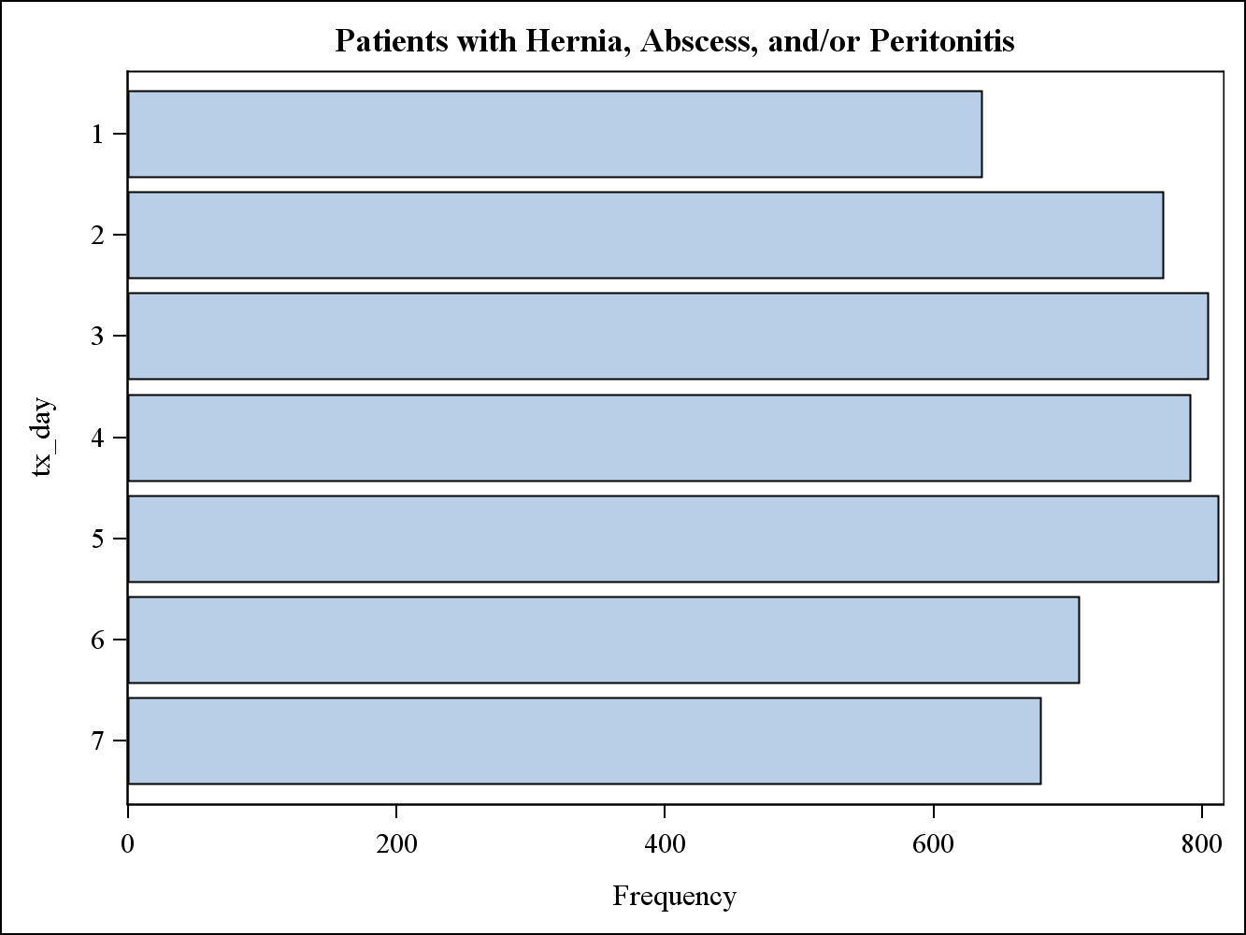
Day of the week when transplanted

Slide 15
When you have a defined date you can perform any mathematical operation
Tomorrow = today() + 1;
Yesterday = today() -1;
Time = Tomorrow – Yesterday;
Duedate = Checkdate + 21;

Slide 16
Example
Data test;
Format Mydate date7.;
Mydate=today();
MyDay=DAY (MYdate);
Myweekday=WEEKDAY (MYdate);
MyMonth=MONTH (MYdate);
MyWeek=Week (Mydate);
MyYear=YEAR (MYdate);
MyQtr=QTR (MYdate);
Run;

Slide 17
Date Constants
1.) Constant Example
‘ddmmmyy’d ’25SEP12’d
‘ddmmmyyyy’d ’25SEP2012’d
2.) With the mdy function:
today_dt =mdy(10, 4,2013);
Christmas=mdy(12,25,2013);

Slide 18
Computing Length of Stay
Incorrect:
LOS= Dt_discharge – dt_admission;
Correct:
LOS= Dt_discharge – dt_admission + 1;
Computes length of stay in days

Slide 19
Function for date differences
YRDIF (start_dt, end_date, basis);
‘Actual’ use 365/366 days
‘30/360’
INTCK- counts the numbers of times a boundary has been crossed going from the first value to the second; DIF=intck(‘YEAR’,dob,today)
1/1/2009 To 12/31/2009 => DIF=0
12/31/2009 To 1/1/2010 => DIF=1

Slide 20
Computing Age
DATA age_example;
SET date_example;
Age1=INT((dt_Tx – DOB)/365.25);
Age2=Round ((dt_Tx – DOB)/365.25,1);
Age3=INT((Today() – DOB)/365.25);
Age4=Round ((Today() – DOB)/365.25,1);
Age5=INT ((’17SEP09’d – DOB)/365.25,1);
Age6=INT(YRDIF(DOB,dt_tx,’Actual’));
RUN;

Slide 21
Computing Differences in month
DATA age_example;
SET date_example;
Diff1= (dt_Tx – DOB)/30.4375;
Diff2=INTCK(‘month’,DOB,dt_Tx);
Run;

Slide 22
Substituting missing parts
/* Read rmonth rday and ryear in separate variables */
If missing(rday) then dob=mdy(rmonth,15,ryear);
else dob=mdy(rmonth,rday,ryear);

Slide 23
Incomplete Dates day of event may be unknown
Data test;
Format xdate date7.;
Input char_date $ 10.;
Day=scan (char_date,2,’/’);
If day ne ‘ ‘ then xdate=input(char_date,mmddyy10.);
else
Xdate=mdy(input(scan(char_date,1,’/’),2.),15,
input(scan(char_date,3,’/’),4.));
Datalines;
12/09/2009
4/13/2009
3/ /2008
;

Slide 24
Date & Time Functions
Datetime()
Time ()
DHMS (date, hour, minute, second);
Hour
Minute
Second

